Slide 1
DESIGN AND OPTIMIZATION OF HIGH PERFORMANCE SRAM
GUIDE : Prof. Ashwini Desai
NAME | USN | ROLL NO
ALLENA MULA | 02FE21BEC006 | 05
BASAVESH PATIL | 02FE21BEC018 | 15
HARSH A PATIL | 02FE21BEC035 | 32
PRATIK PATIL | 02FE21BEC063 | 58

Slide 2
CONTENT
Project Planning (Gantt chart) and WBS (Work Breakdown Structure).
Specification and identification of of Input & output.
Functional block diagram relating input & output.
Simulation of the design using any open source.
Detailed block diagram.
Integrating the functional blocks, debugging details and partial demo results.
Plan and need for optimization.

Slide 3
Gantt chart
Week 1-3
Week 4-6
Week 7-9
Week 10-12
Phase 1
Phase 2
Phase 3
Phase 4
Problem Statement ,
Literature Review
Project Planning,
Simulation and
implementation.
Transistor level
optimization,
verification of design.
SRAM verification
Documentation.

Slide 4
WBS (Work Breakdown Structure)
SRAM DESIGN
Initiation
Planning
Execution
Optimization
Identifying the problem
Identifying multiple solution and finding best suited
Verifying the read and write operations
Transistor level optimization
Problem Definition and need statement
Simulation of the design using cadence 45nm
Calculating different parameters
Comparing the different parameters
Literature survey
Area optimization

Slide 5
Specification and identification of Input & output
There are 2 outputs and 4 inputs in the 6t SRAM design they are
input : WL,Bitline,bitline_bar. And output are p and q
WL : if WL =1 then read and write operations are possible and if WL = 0 then it is in the hold stage
p and q : These are the 2 output were read and write operation takes place
bit and bit_bar(input) : These 2 will act as input when we have to write the memory
bit and bit_bar(output) : These 2 will act as output when we have to read the memory

Slide 6
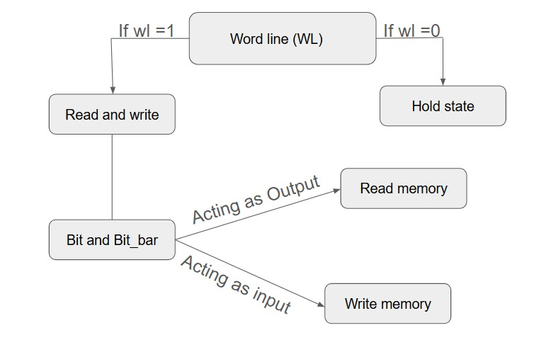
Functional block diagram relating input & output.
Drivable

Slide 7
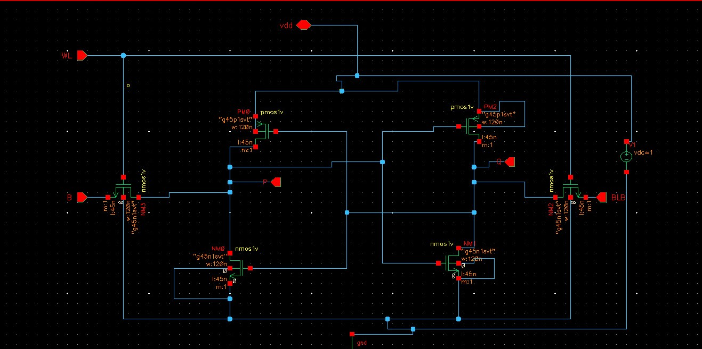
Simulation of the design using any open source.
6T SRAM design

Slide 8
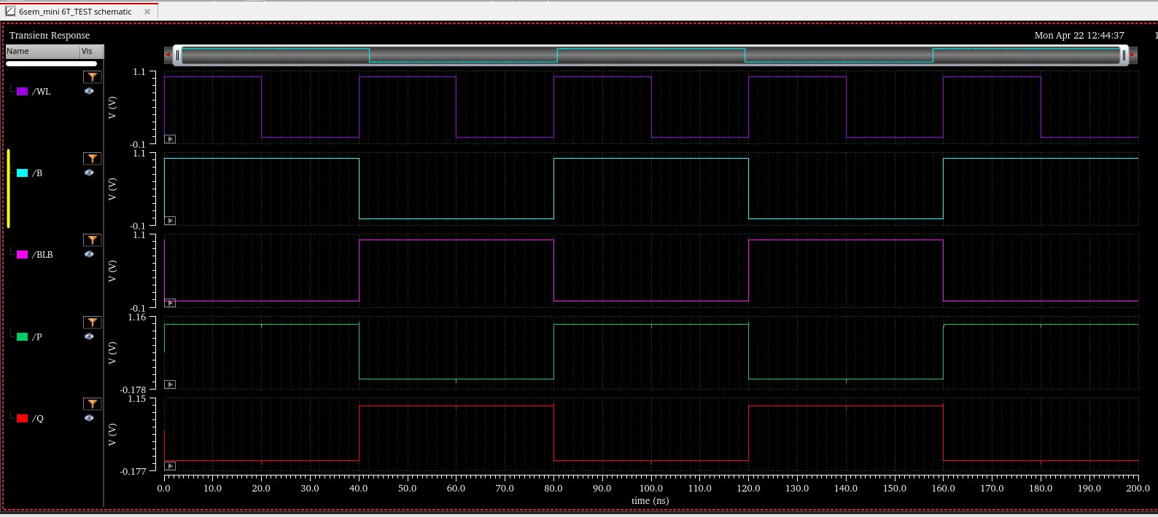
Waveforms :

Slide 9
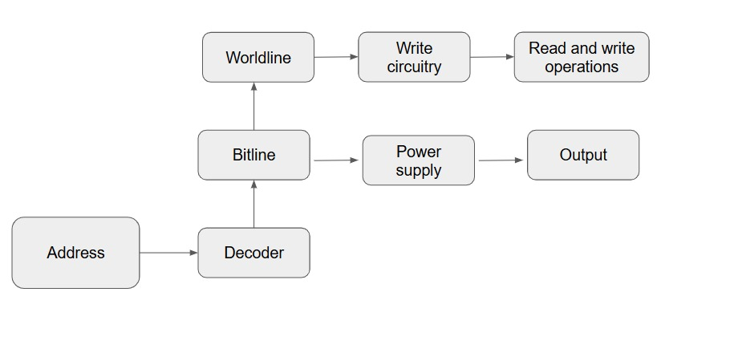
Detailed block diagram :

Slide 10
Partial demo results :
Transient analysis
Average power calculation
power = 14.34 e-9 W

Slide 11
Plan and need for optimization:
The need for optimization are as follows :
The designed model consumes more average power
Layout area of the cells
Complexity and delay for the operations
The proposed plan for optimization :
Optimizing the 6T SRAM at transistor level and reducing the layout area of the cells
The average power consumed will be less in 8T SRAM design

